Slide 1
GOOOAAAL!
SC1015 Project:
OPTIMU Analytics
Ang Kai Jun
Chay Hui Xiang
Ivan Loke Zhi Hao

Slide 2
Agenda
1
2
3
4
5
6
Problem Identification
Data Preparation
EDA
Machine Learning
Insights
Future Works
Problem Statement, Motivation
Datasets Used,
Data Gathering, Pre-Processing
Initial Insights
& Visualization
Pre-Processing
& Model Training
Project Outcomes
& Insights
Analysis Pipeline Improvements

Slide 3
Problem Identification Motivations | Problem Statement

Slide 4
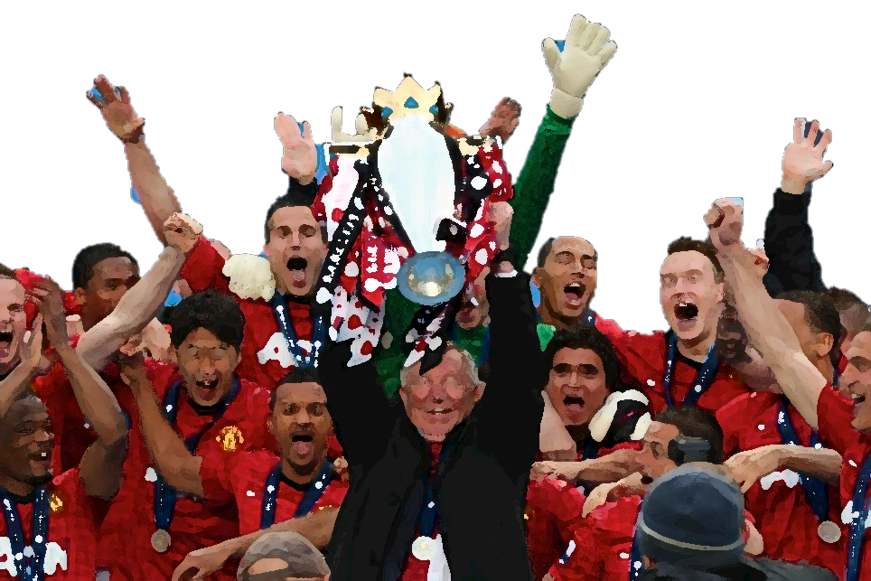

Ever since Manchester United’s last Premier League win in 2012/13...

Slide 5

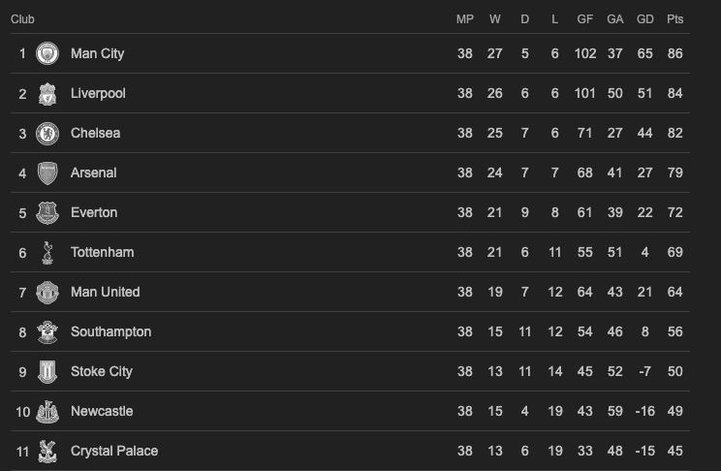
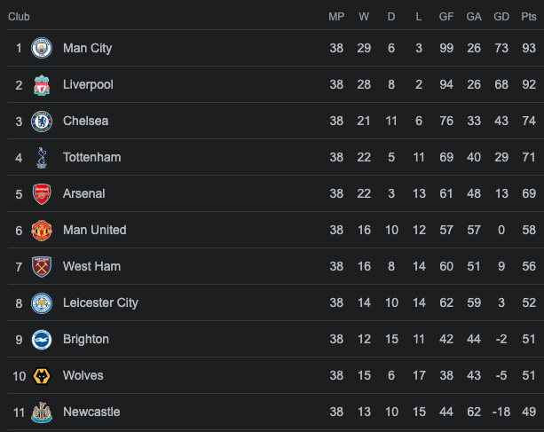
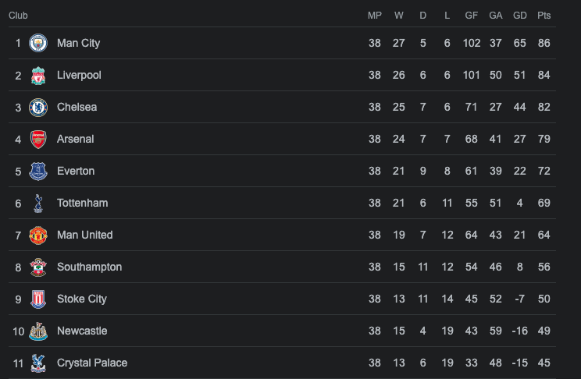
2013/14 Premier League Table
2021/22 Premier League Table
…the club’s performances have nosedived over the past decade.

Slide 6
Reasons for Manchester United’s poor performances
1
Poor Business Management
Manchester United’s owners, the Glazers, have been accused of negligence and poor debt management.
2
Managerial Instability
After the retirement of Sir Alex Ferguson in 2013, the club has gone through several managers who have struggled to replicate his success.
3
Poor transfer policy
Over the past few years, Manchester United has been criticised for leaving deadwood in the team and paying excessively high transfer fees for players.

Slide 7
Poor transfer policy
3
Over the past few years, Manchester United has been criticised for leaving deadwood in the team and paying excessively high transfer fees for players

Slide 8
Data Science?
Machine Learning?
3
Problem Statement
How can Manchester United better optimise its transfer strategy to improve the team performance?
Exploratory Data Analysis?

Slide 9
Data Science?
Machine Learning?
3
Problem Statement
How can Manchester United better optimise its transfer strategy to improve the team performance?
Exploratory Data Analysis?

Slide 10
3
Data Science Oriented Approach
Determine suitable transfer prices for high performing players to let in via current player valuation predictions
Determine poor performing players to let go via anomaly detection pipelines

Slide 11
Data Preparation Data-Gathering | Pre-Processing

Slide 12



Dataset Formulation
Transfermarkt
FBref
Kaggle
Data of all transfers over the past few years
Comprehensive football match statistics
Transfermarkt player valuation data scraped & processed by other Kaggle users

Slide 13
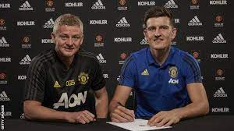
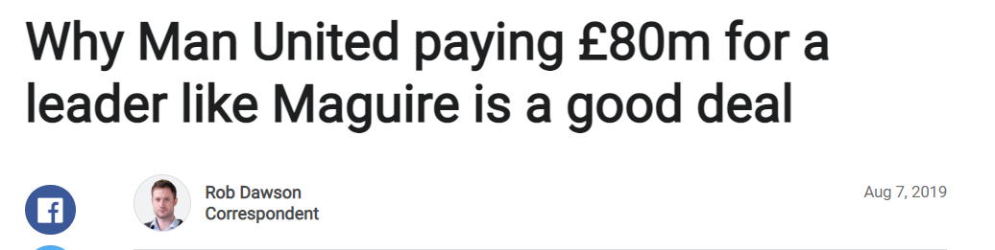
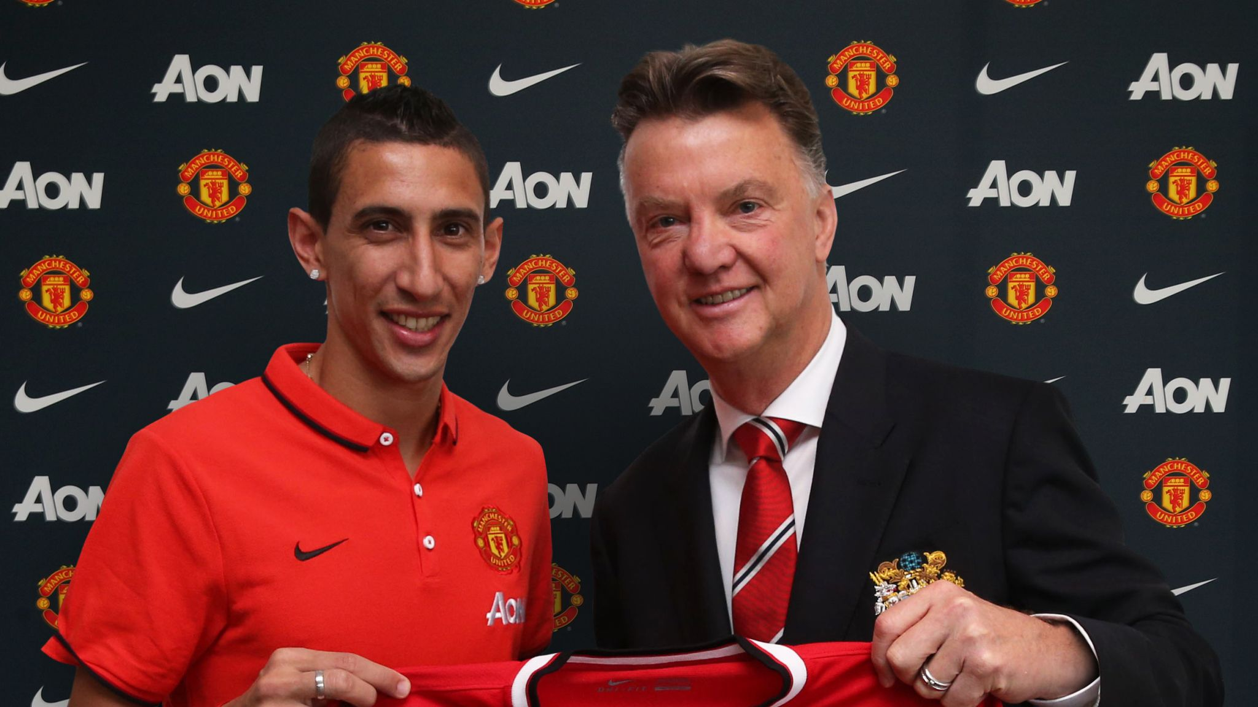
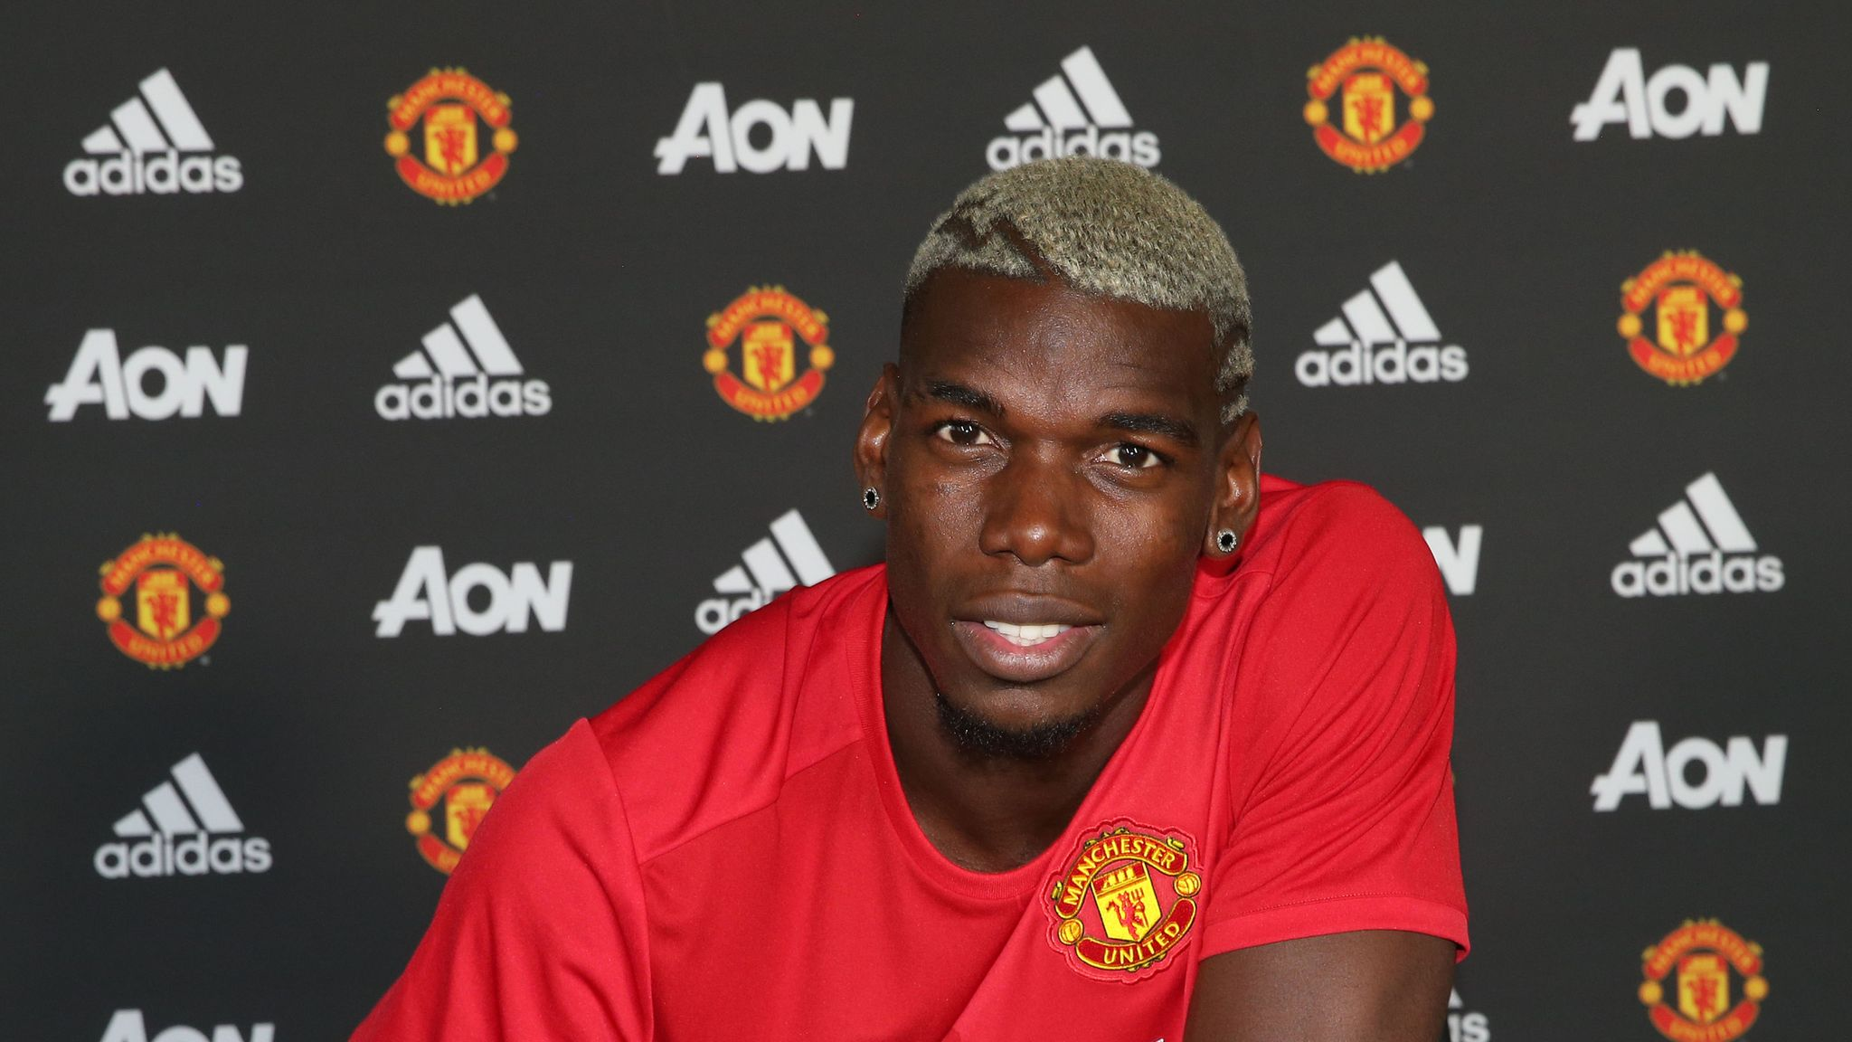
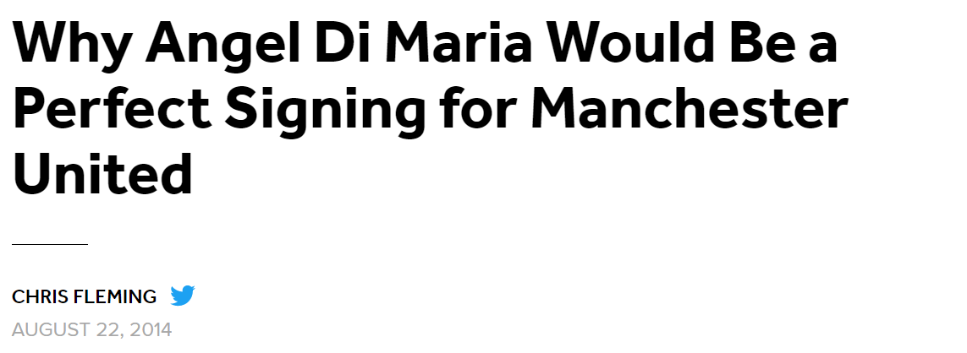
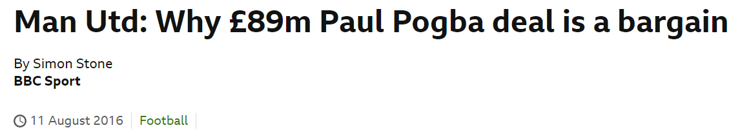
Player Valuation
$87 million
$59 million
$89 million
High price

Slide 14
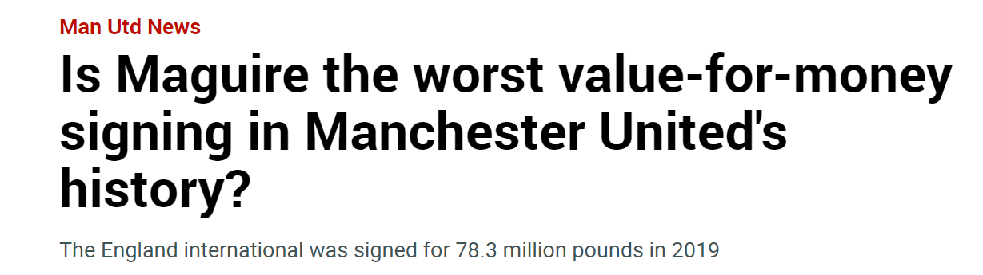
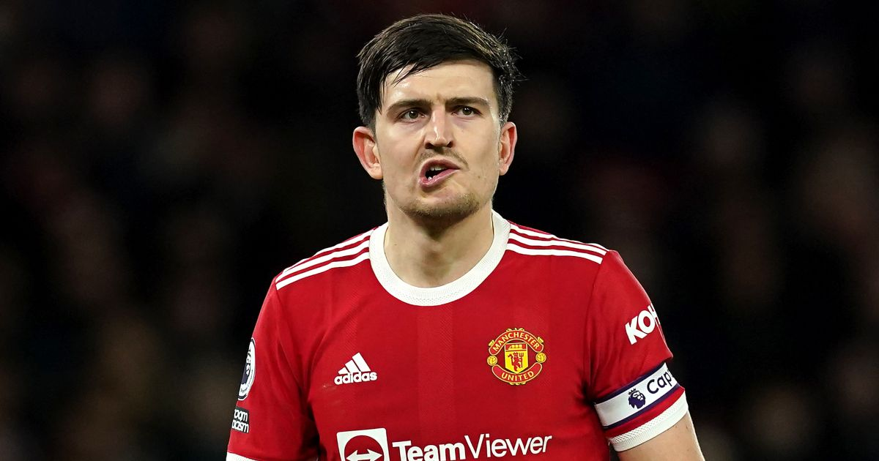

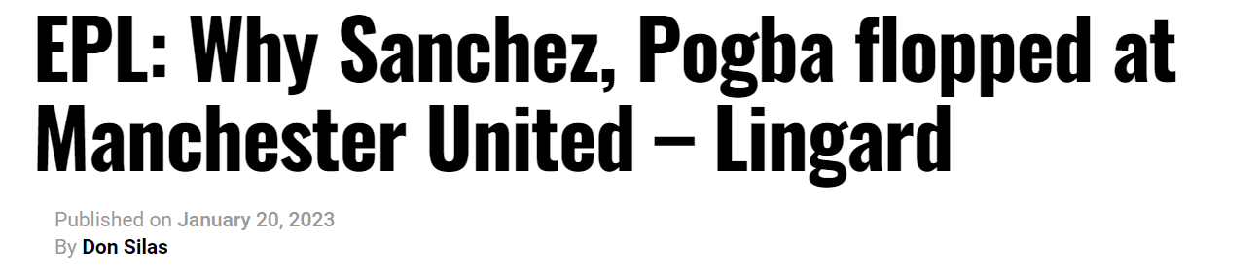
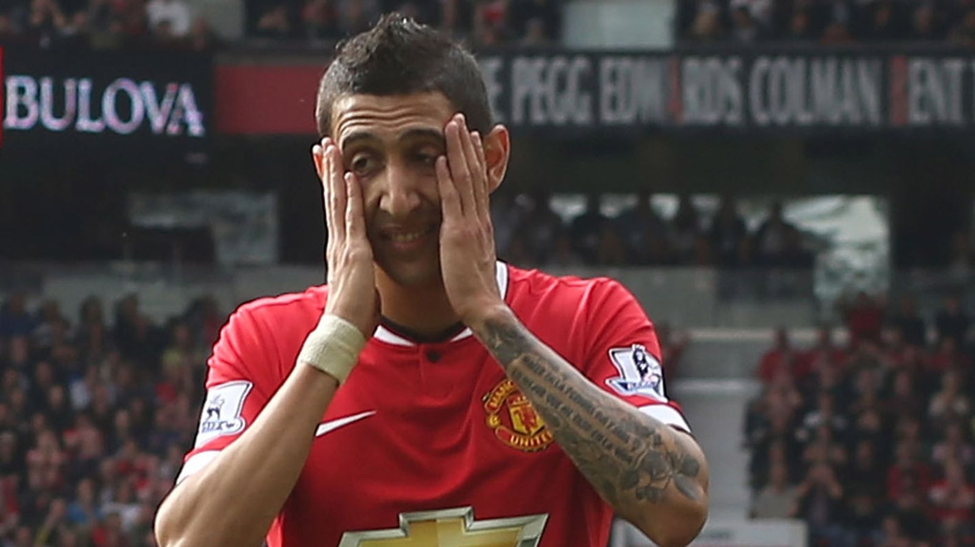
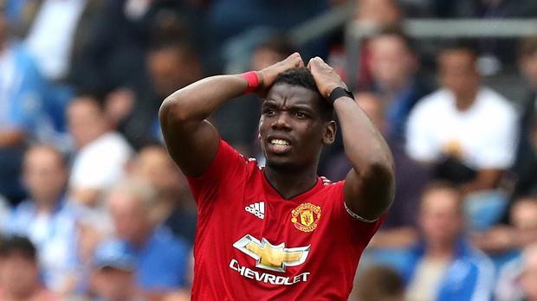
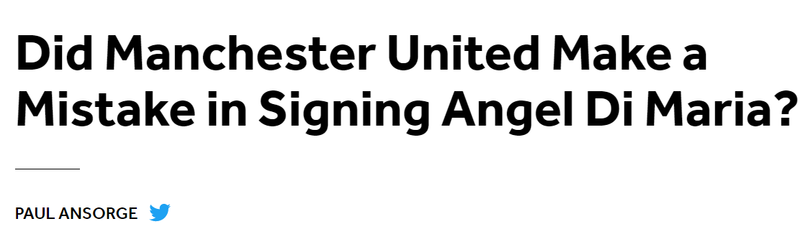
Player Valuation
$87 million
FLOP
FLOP
FLOP
$59 million
$89 million
High price
Poor results?

Slide 15
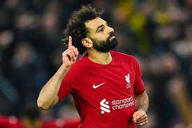
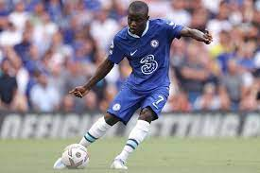
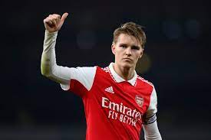
Player Valuation
Mo Salah
N'Golo Kanté
Martin Ødegaard
Need to accurately determine player’s true value
$42 million
$35 million
$35 million
EPL Champion
FA Community shield Champion
FA Cup Champion
Champions League Runner Up
UEFA SuperCup Champion
FIFA Club Word Cup Champion
Champions League Champion
Currently 1st in the EPL
FA Community shield Champion
FA Cup Champion

Slide 16






Player Valuation
Common data points
Uncommon data points
Goals per 90
Citizenship
Number of goals scored for every 90 minutes played that season
Country that a player plays for
Assists per 90
Median transfer fee of club
Data Cleaning: Playing League == ENGLISH PREIMER LEAGUE & Season >= 2017-2018
Number of assists provided for every 90 minutes played that season
Median sum of money a player’s club has spent on buying players in the last 3 seasons
Age
Foot
Age of player during the season
The player’s strong foot. Can be any or a combination of feet

Slide 17
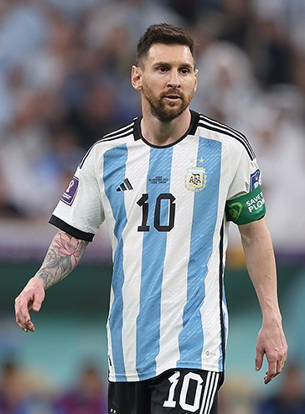
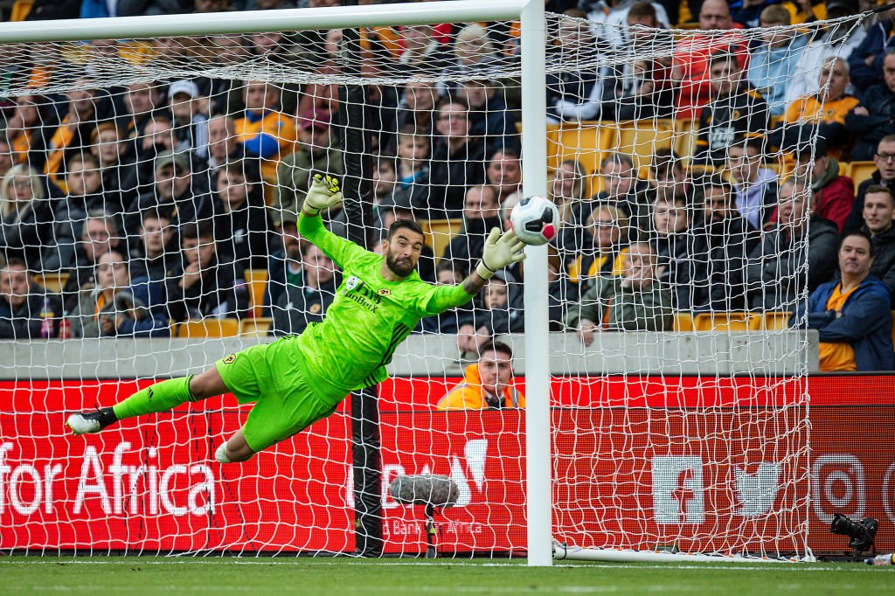
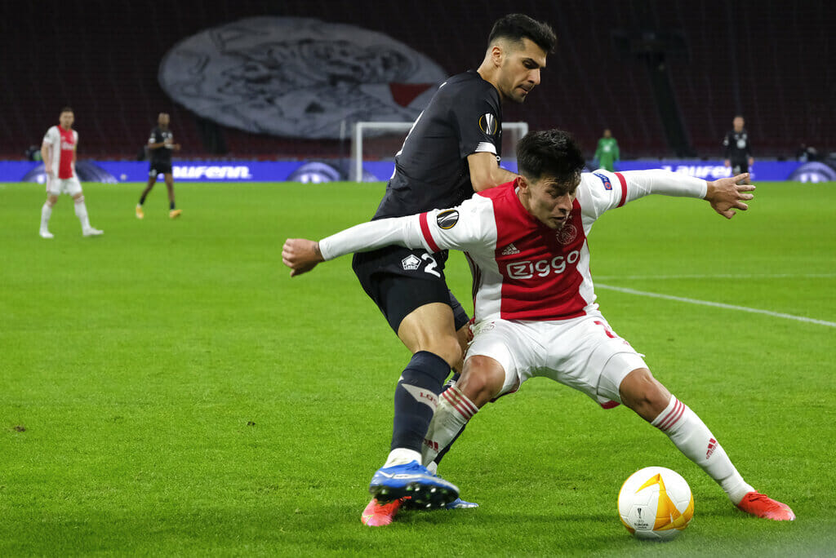
Anomaly Detection
Need to find global metric
Striker
Goal Keeper
Defender
No. of Goals Scored
No. of Assists
No. of Goals Against
No. of Saves
No. of Dribbles Tackled
No. of Shots Blocked

Slide 18
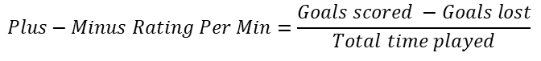
Anomaly Detection
Plus-Minus Rating Per Min
Player Rating & Potential
Metric commonly used to study the contributions of individual players in a team
Directly measures the players contribution to the team’s success based on a certain goal metric
Per Min is used to account for differences in playing time
Data Cleaning: Duration played per match > 10mins & Total Duration played per season > 450mins
Metric provided by EA Sports based on statistical evidence and expert valuations
Player Rating: Reflects players’ overall ability and performance
Potential: Reflects the players’ room for future growth
$$Plus−Minus Rating Per Min=\frac{Goals scored −Goals lost}{Total time played}$$

Slide 19
Exploratory Data Analysis Initial Insights & Visualisation

Slide 20
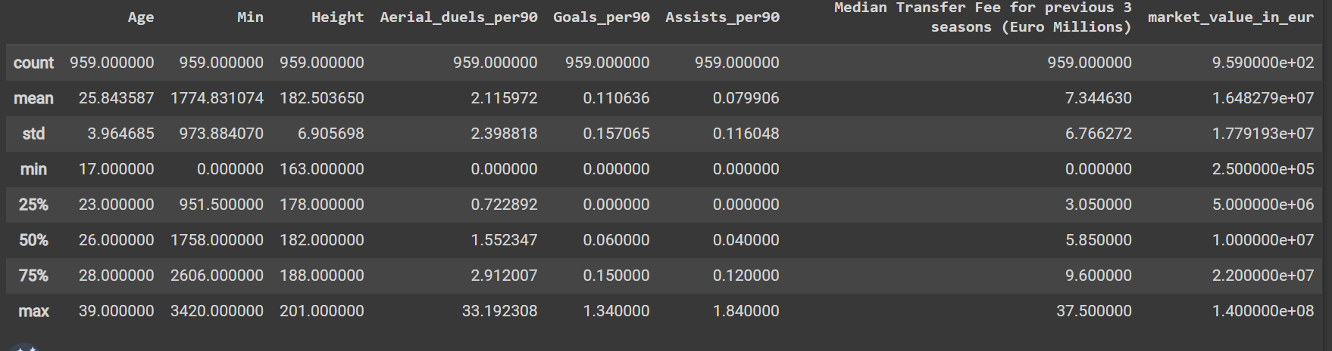
Univariate Analysis of Player Valuation
df.describe()

Slide 21
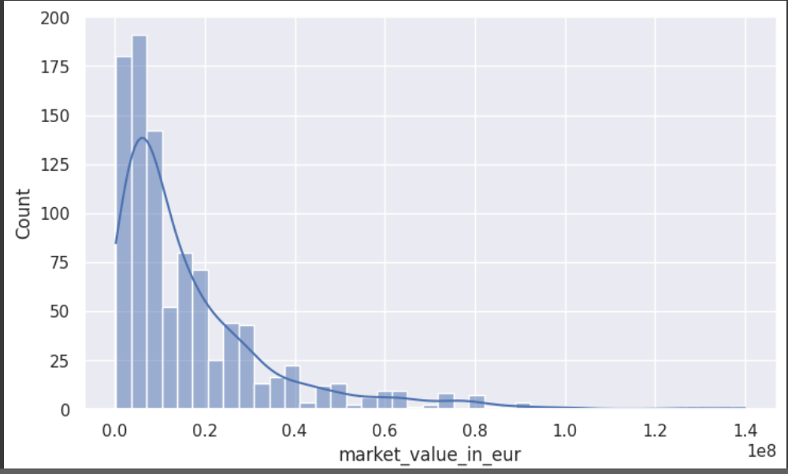
Univariate Analysis of Player Valuation
Non-normal distribution curve
Expected for a real-world dataset
General Trend: There exists a positive skew with a wide range of market values for the top 50 percentile of players
Clubs are willing to pay a huge premium to sign the most desired players

Slide 22
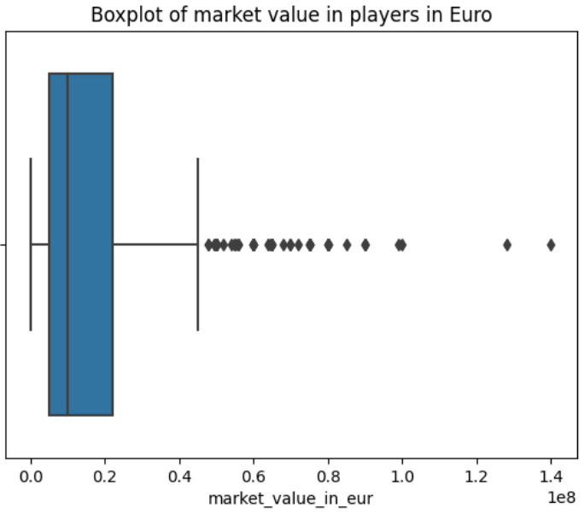
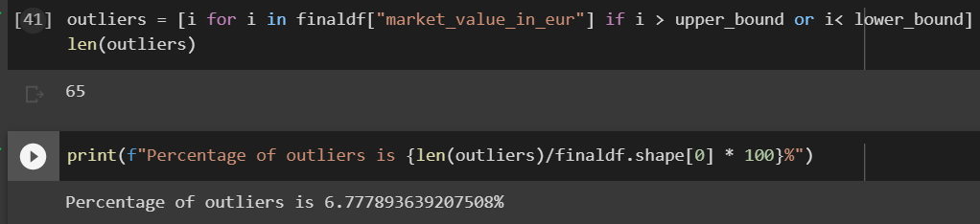
Univariate Analysis of Player Valuation
Positive skew in our dataset
Sizeable number of outliers in our dataset

Slide 23
Fun Fact about Player valuation!

Slide 24
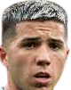
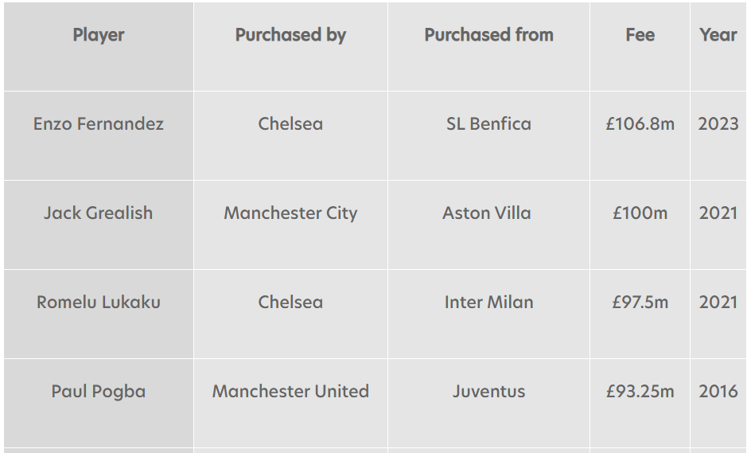
Fun Fact about Player valuation!
Around 10x times the price of an average EPL footballer!

Slide 25
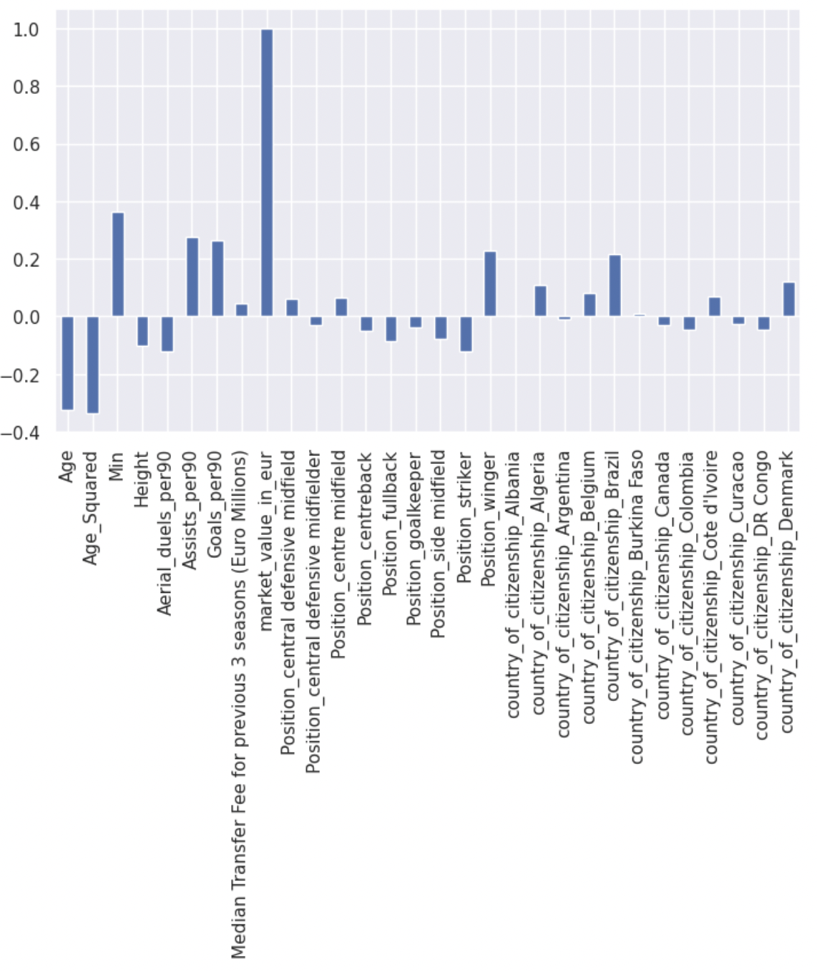
Multi-variate Analysis of Player Valuation
Bar Graph showing correlation between Market Value and other factors
4 factors with highest correlation:
Age
No. of Minutes played
No. of Assists per 90mins
No. of Goals per 90mins

Slide 26
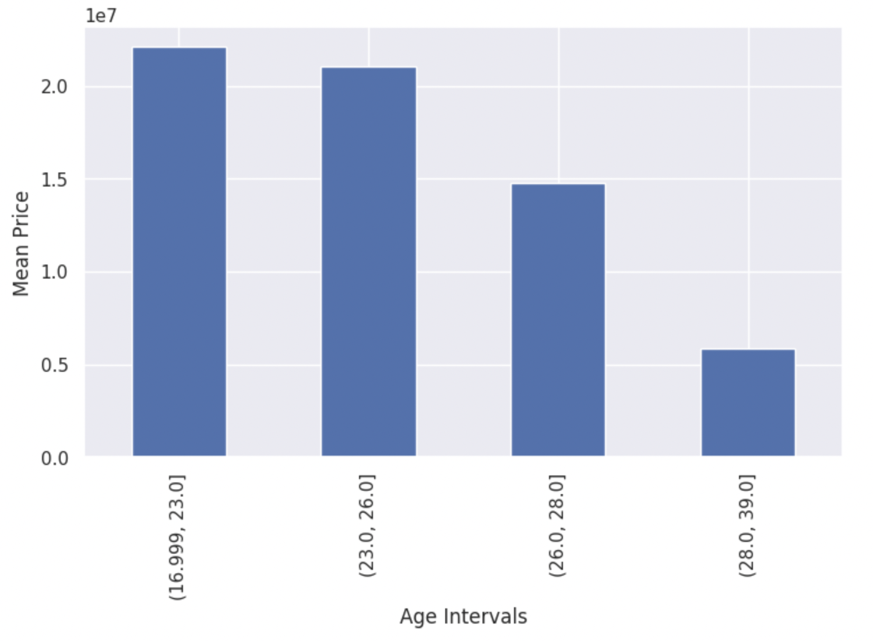

Correlation between Price and Age
Bar Graph of Mean Price against Age Interval
General Trend: Older players are generally priced lower than younger players
Q1
Q2
Q3
Agrees with common consensus:
Player performance decreases as age increases
Increased susceptibility to injuries with age
Less runway to develop
Q4

Slide 27
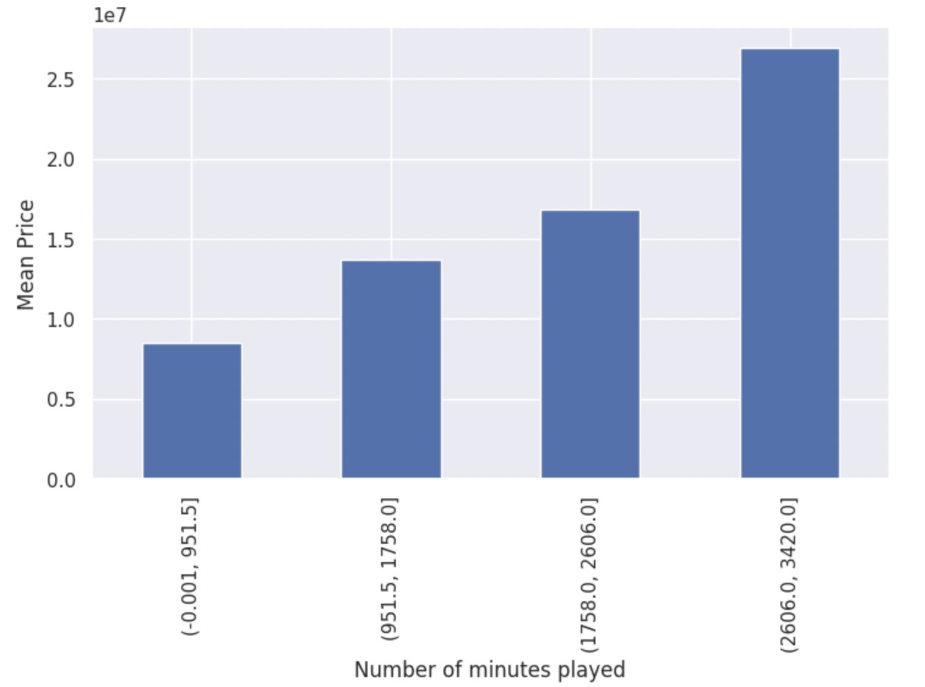
Correlation between Price and Mins played
Bar Graph of Mean Price against Number of minutes played
General Trend: Players who play more minutes per season are valued higher
Q4
Q2
Q3
Agrees with common consensus :
Teams will field better players more often
Players who play more have generally higher performance, and hence higher valuations
Q1

Slide 28
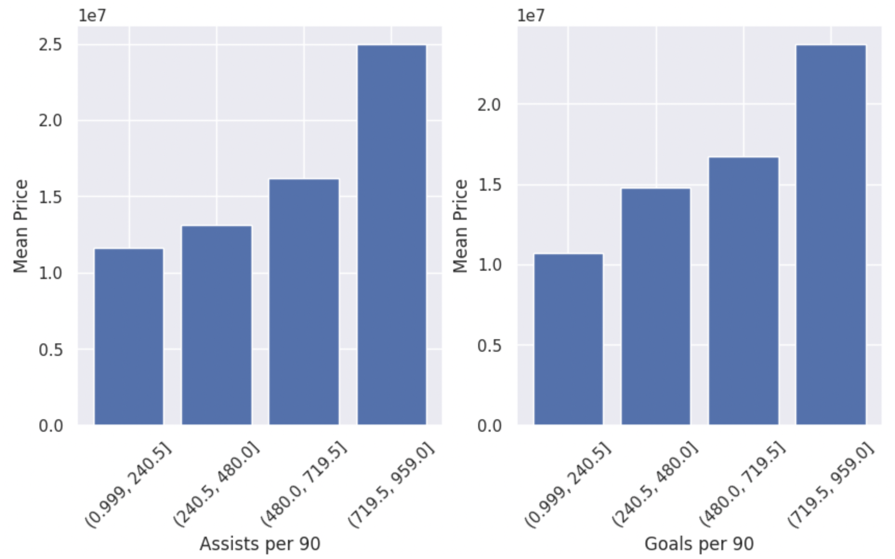
Correlation between Price and Assists/ Goals
Bar Graphs of Mean Price against Goals per 90 & Assists per 90
General Trend: Players that make the most goals and assists after valued more
Agrees with common consensus :
Players that can contribute the most the teams are valued the most
Q1
Q2
Q3
Q4
Q1
Q2
Q3
Q4

Slide 29
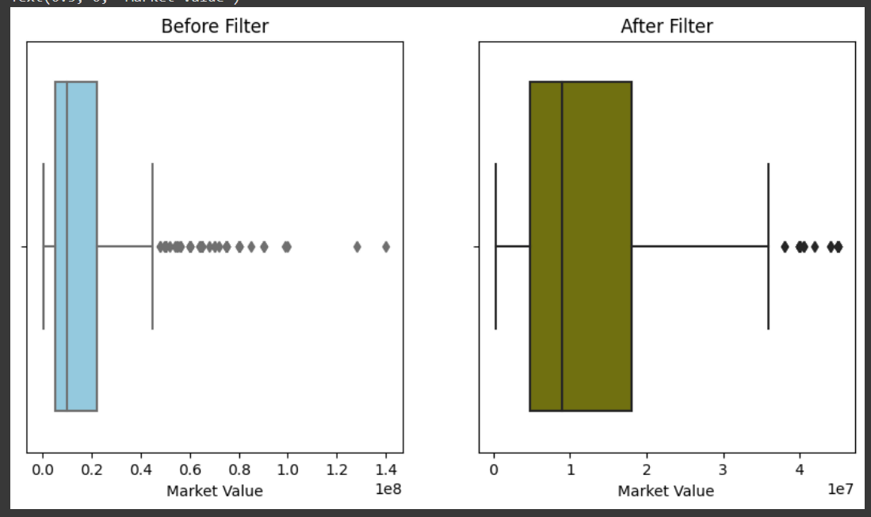
Data Cleaning for Player Valuation

Slide 30
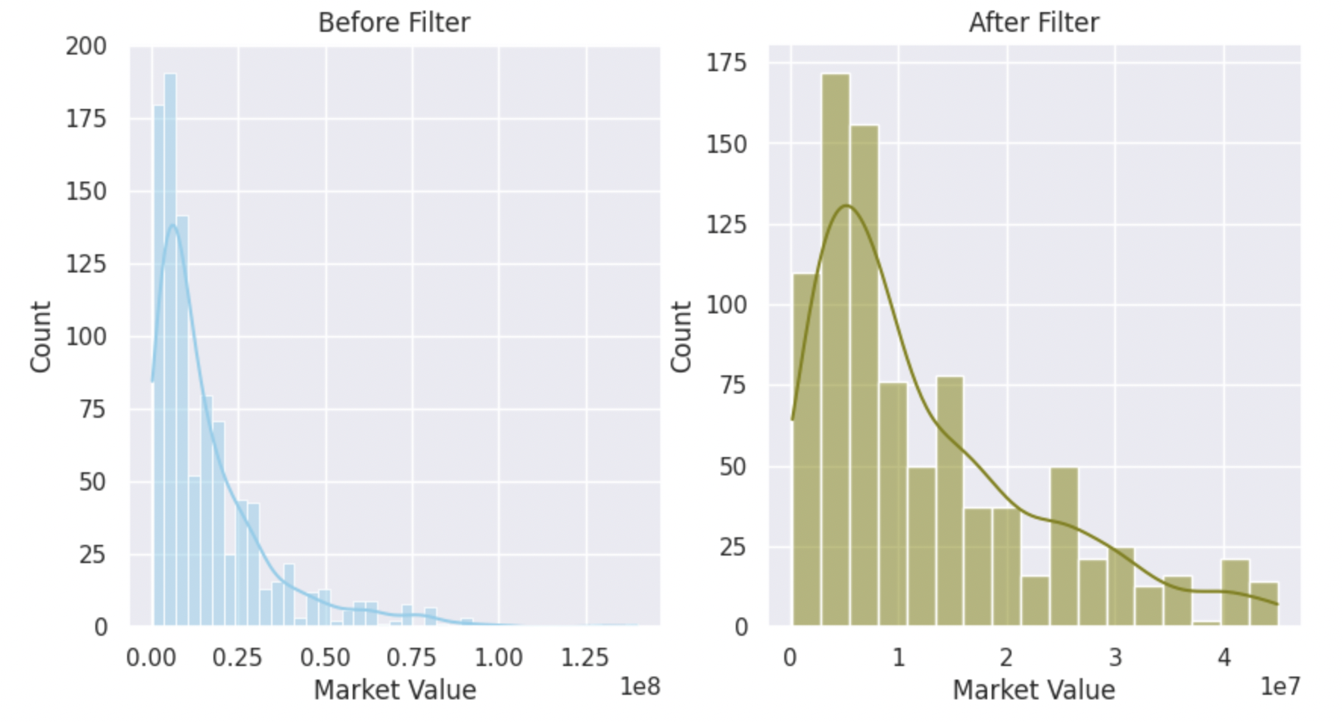
Data Cleaning for Player Valuation

Slide 31
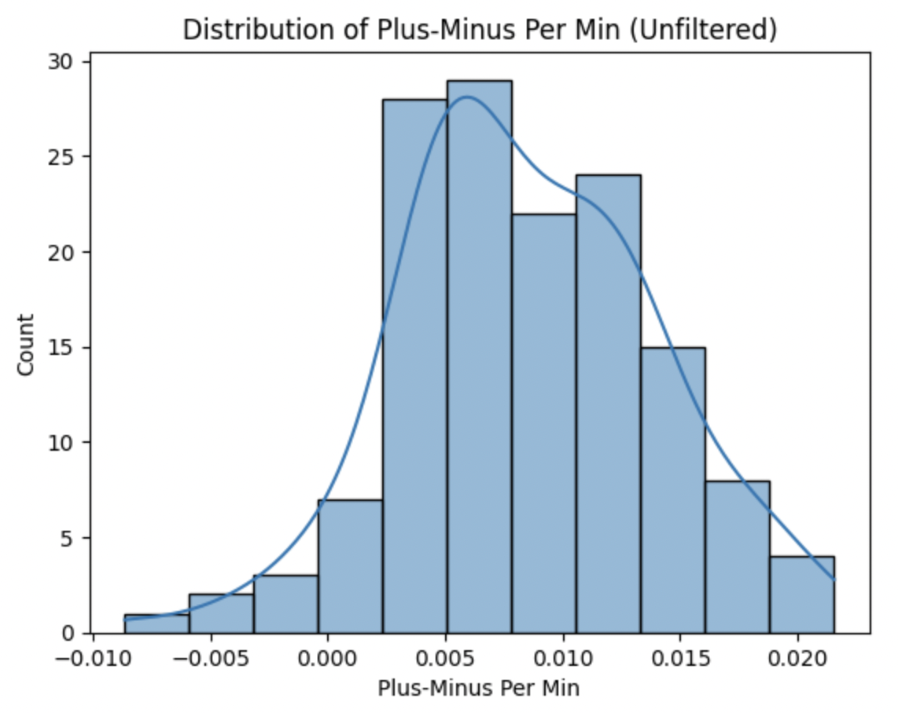
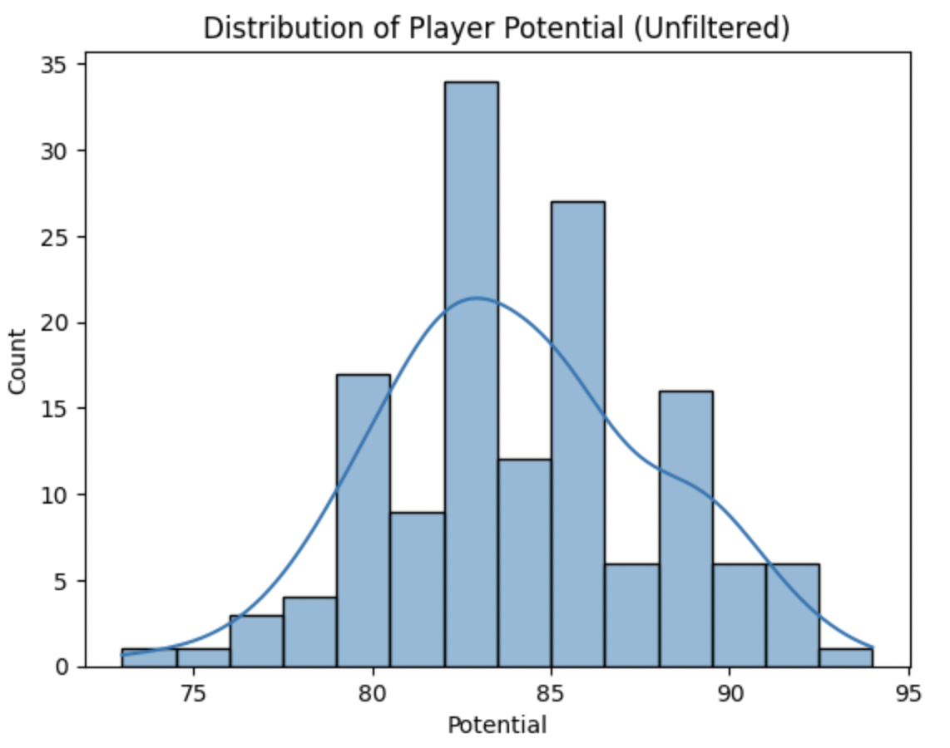
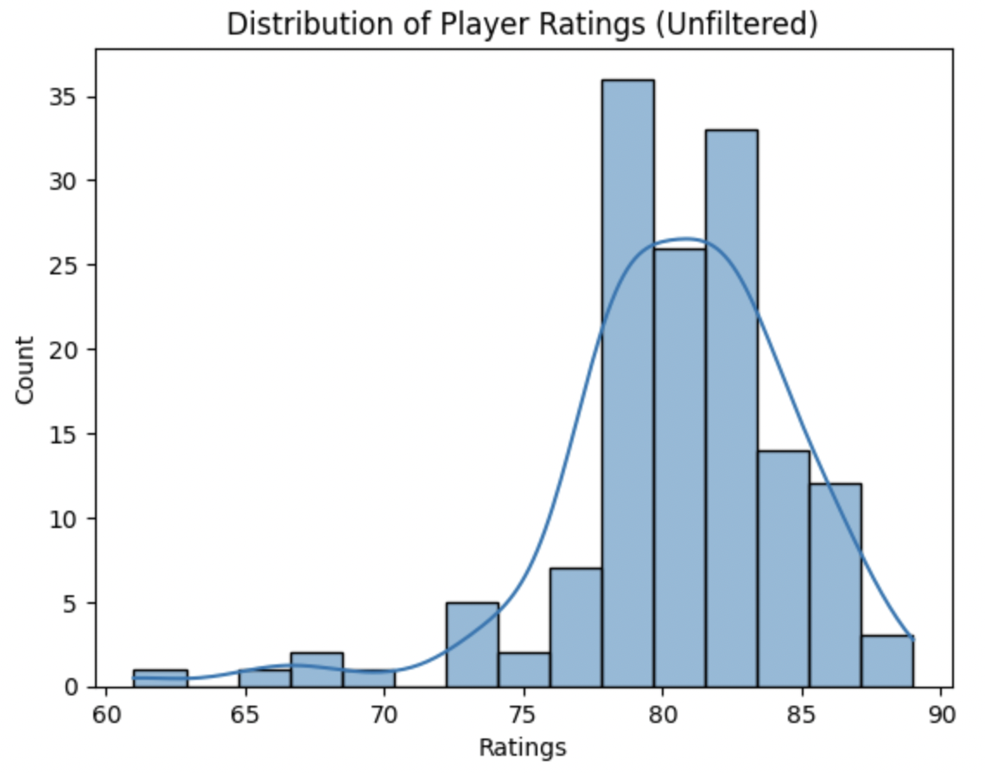
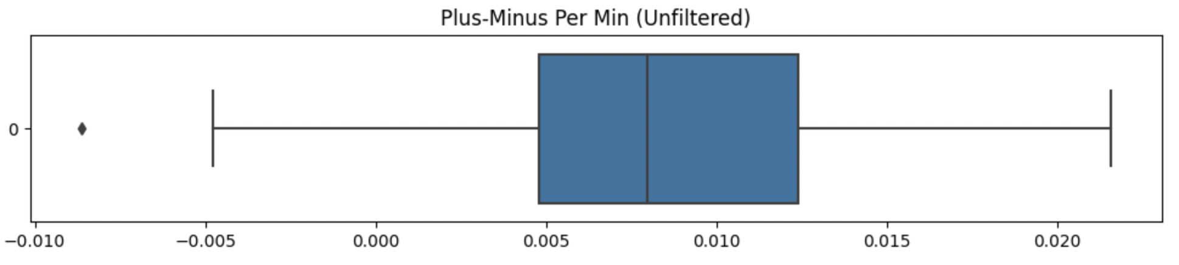
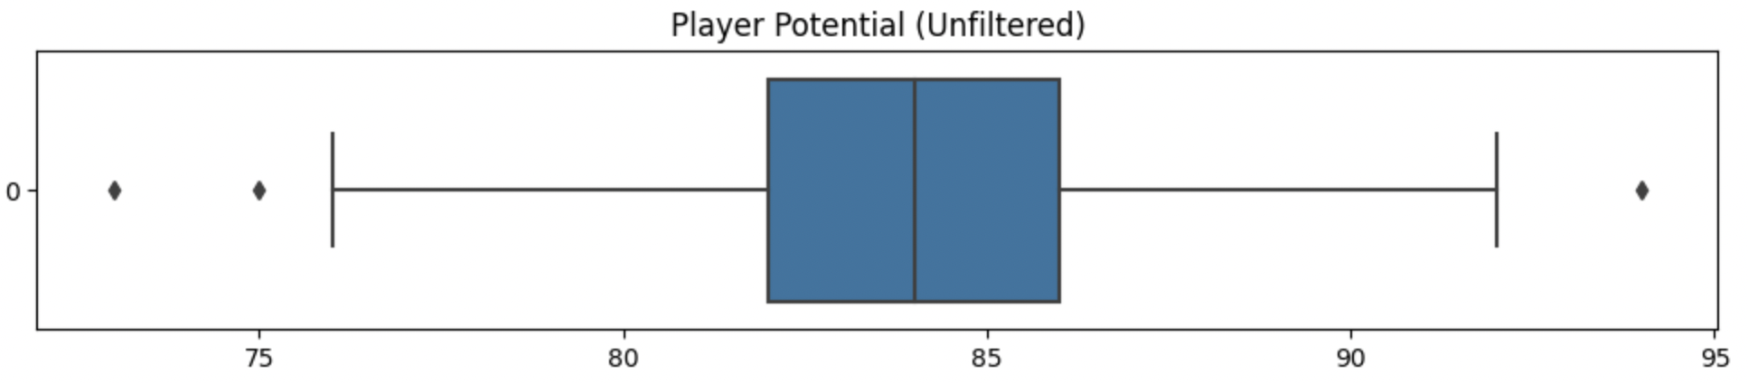
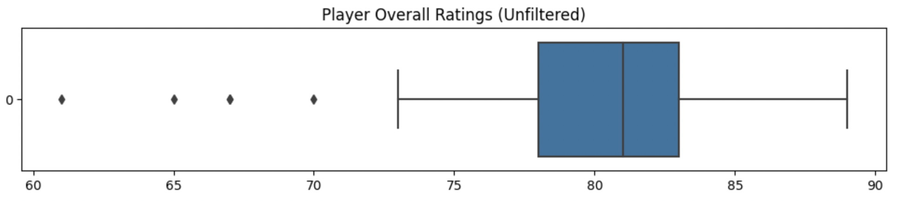
Plus-Minus Per Min
Anomaly Detection
Player Potential
Player Ratings
All 3 metrics show a good distribution across the whole dataset
Most have normal-like distribution, with the exception of Player Ratings due to outliers
The presence of outliers indicate the need for data cleaning

Slide 32
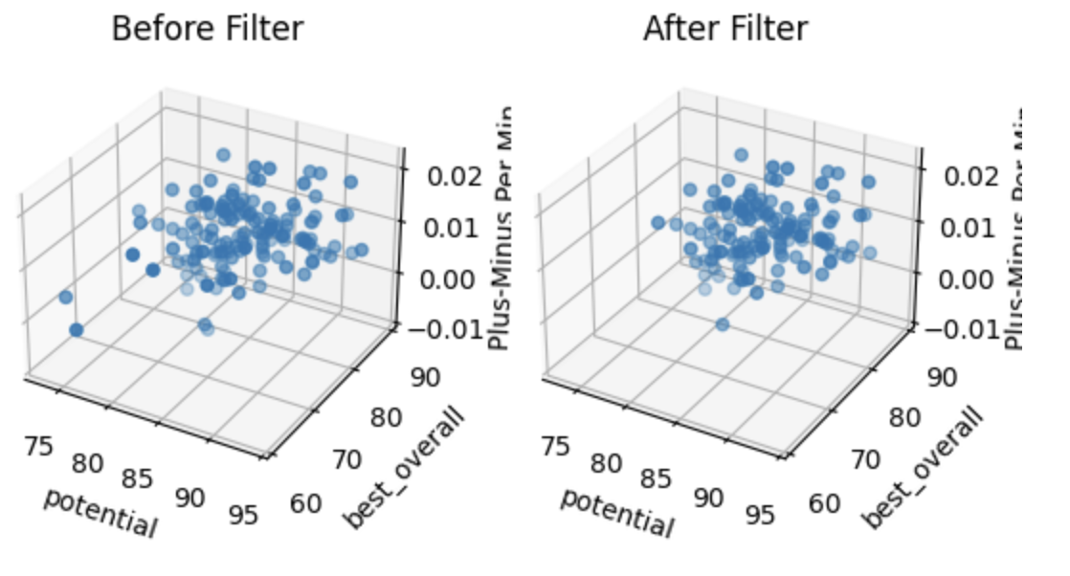
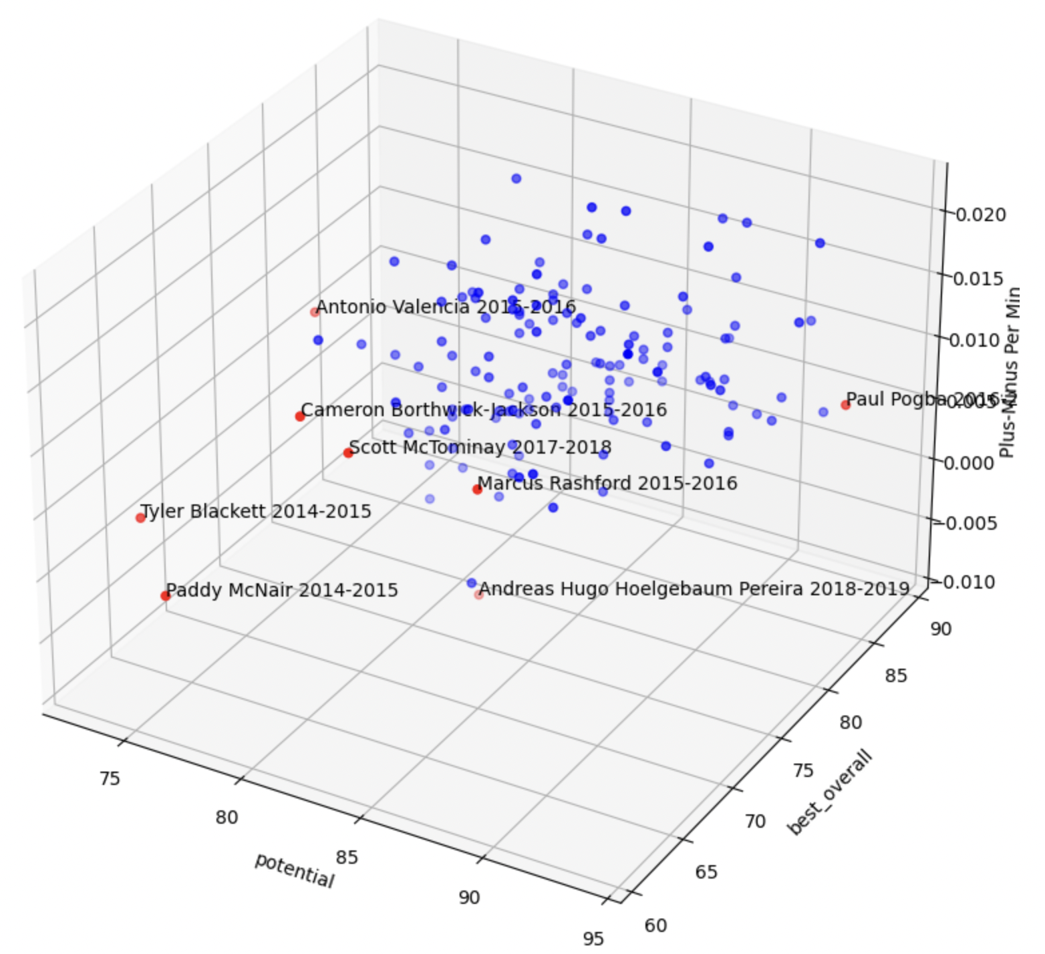
Data Cleaning for Anomaly Detection

Slide 33
Machine Learning Pre-Processing | Model Training
Notes:
Now let us move onto the machine learning portion, and our main analysis pipelines.

Slide 34
Data Preprocessing
Train-test split
MinMaxScaler
Scales features to a range between 0 to 1
Data
Benefits:
Improves performance and stability of machine learning algorithms
Ensure all features contribute equally to our model’s predictions regardless of initial values
Leads to more accurate and reliable predictions
80
20
Notes:
Before training our models, we conducted another round of data preprocessing. This includes splitting the dataset, and scaling the feature columns.
-- IGNORE --
Scaling these features yields many benefits, such as improving the performance and stability of machine learning algorithms by preventing input features with larger ranges of values to dominate over input features with smaller ranges, resulting in better quality of predictions and better quality of training.

Slide 35
x
y
+
y
x
Random Forest Regressor
Support Vector Regressor
x
f1
f2
x
y
+
y
Gradient Boosting
Artificial Neural Network
Notes:
For our player valuation analysis, we will be looking at these 4 different model architectures.
-- IGNORE --
As you can see via the illustrations here, both random forest regressor and gradient boosting are decision tree-ensemble based algorithms, support vector regressor works on a best fit hyperplane while artificial neural network is based on the fundamental theories of deep learning and backpropagation.

Slide 36
x
y
Ensemble machine learning algorithm that builds multiple decision trees and combines their predictions to make more accurate predictions
Machine learning algorithm that finds the best hyperplane to separate data points while minimizing error by using support vectors to define the optimal boundary
+
y
x
Random Forest Regressor
Support Vector Regressor
x
f1
f2
Similar to RFRs, but builds decision trees sequentially, and corrects the errors of previous models through boosting
Machine learning model that simulates the behaviour of the human brain by using interconnected nodes and layers to process and learn from data
x
y
+
y
Gradient Boosting
Artificial Neural Network
Notes:
As you can see via the illustrations here, both random forest regressor and gradient boosting are decision tree-ensemble based algorithms, support vector regressor works on a best fit hyperplane while artificial neural network is based on the fundamental theories of deep learning and backpropagation.
-- IGNORE --
The random forest regressor is a more advanced version of the conventional decision tree, as it combines the output from multiple sets (or forests) of decision trees to make more accurate predictions. The random forest regressor is an extremely versatile regression algorithm, being able to handle large datasets efficiently with a high degree of accuracy.
The support vector regressor, depending on the kernel type, creates a best-fit hyperplane for the data. If a linear kernel is used, the resulting hyperplane will be flat, and the SVR model will fallback onto a linear regression model, while if a non-linear kernel function such as the rbf in our case is used, the resulting hyperplane will be non-linear.
Gradient Boosting works extremely similarly to random forest regressors, with the key difference being how the decision forests are constructed. Each forest is created sequentially, instead of a sporadic or random manner in the case of RFRs.
Finally, we have a deep learning model variant, in the Artificial Neural Network, or ANN for short. The ANN contains multiple layers of neurons, with each neuron having an associated set of weights and biases. These weights and biases are updated for every batch of data fed in, via a technique known as backpropagation.

Slide 37
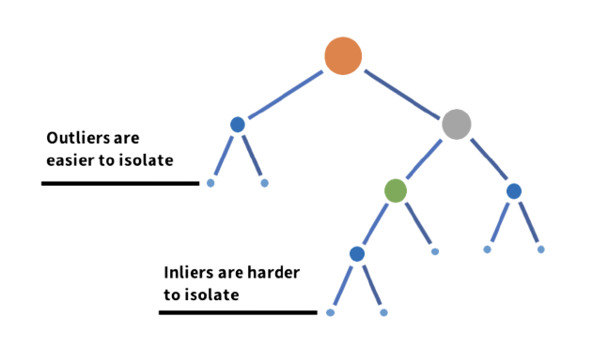
y
x
Isolation Forest
One Class Support Vector Machine
y
Iteratively updated
Bottleneck
x
Encoder
Decoder
SGD One Class Support Vector Machine
Deep AutoEncoder
Notes:
For anomaly detection, these 4 different model architectures will be used.
-- IGNORE --
As you can see via the illustrations here, both one class support vector machine and sgd one class support vector machine follow the principles of a conventional SVM. The isolation forest is a tree based algorithm, while the deep autoencoder follows a deep model structure, similar to the ANN.

Slide 38
y
Machine learning algorithm that randomly partitions data into subsets to construct isolation trees for the detection of anomalies
Similar to Support Vector Regression, but instead is trained on a single class of data and learns to distinguish between normal and abnormal data points
x
Isolation Forest
One Class Support Vector Machine
y
Iteratively updated
Bottleneck
Similar to One Class Support Vector Machine but differs but using gradient descent optimization to iteratively update the parameters of the hyperplane to minimize the objective function
Artificial neural network that compresses input data into a lower-dimensional representation in the encoder and then reconstructs it in the decoder for anomaly detection
x
Encoder
Decoder
SGD One Class Support Vector Machine
Deep AutoEncoder
Notes:
As you can see via the illustrations here, the isolation forest is a tree based algorithm. Both one class svm or ocsvm for short and sgd ocsvm follow the principles of a conventional SVM. while the deep autoencoder follows a deep model structure, similar to the ANN.
-- IGNORE --
The isolation forest works by isolating anomalous observations into small partitions of the data space. It does this by randomly selecting a feature and a split value to create a decision tree that recursively partitions the data until anomalies are isolated into small partitions. Anomalies are identified as data points that require fewer partitions to be isolated.
The one class support vector machine, or ocsvm for short, as well as the stochastic gradient descent ocsvm, work on similar principles, by defining a hyperplane that encloses as many normal data points as possible while excluding the rest of the data points. During training, the model learns the parameters of the hyperplane using only normal data points. During testing, data points that fall outside the hyperplane are considered anomalous. The SGD OCSVM and OCSVM differ in terms of the hyperplane optimisation.
The deep autoencoder is a variant of the conventional ANN, that reduces the dimensionality of the input data via an encoder, and reconstructs the original input from the lower dimensional data via a decoder. The neural network will be trained on normal data. When applied on anomalous data, it will face difficulties trying to reconstruct these data, and these anomalies can thus be separated by their higher reconstruction error.

Slide 39
Insights and Conclusions Project Outcomes & Insights
Notes:
Without further ado, let’s dive into the insights and conclusions from our project.

Slide 40
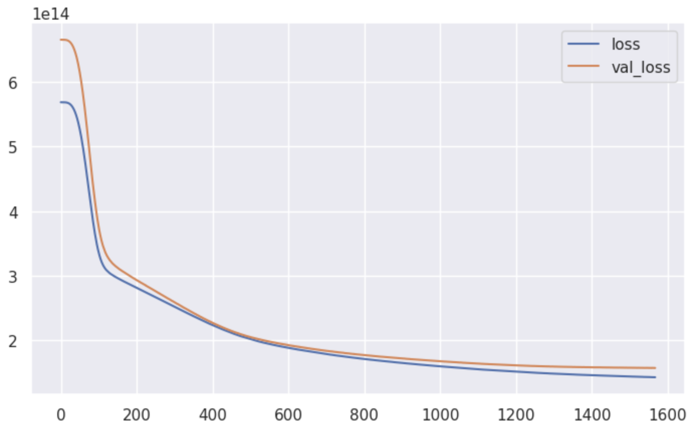
Player Valuation Artificial Neural Network
Hyperparameters | Values
No. of Hidden Layers | 2
Epochs | 2000 with early stopping
No. of Dense Units | 68, 32, 8, 1
Batch Size | 32
Model Evaluation Metric | Values
RMSE | 12553919.35
MAE | 7906289.08
R² | 0.51936279
Training Metrics
Notes:
For player valuation predictions, the training metrics from our ANN training as shown on the left, with the hyperparameters on the right.
From first glance, the RMSE and MAE values might seem large, but we have to keep in mind that the neural network is predicting data in magnitudes of millions, as player valuations typically go in millions of euros.

Slide 41
Player Valuation Random Forest Regressor
Hyperparameters | Values
No. of trees | 100
Max Depth | None
Min Samples Split | 2
Min Samples to be a leaf node | 1
Model Evaluation Metric | Values
RMSE | 6637550.86
MAE | 4269030.73
R² | 0.64512963
Notes:
Here’s the hyperparameters and model evaluation metrics for the RFR,
-- IGNORE --
Likewise, here are the hyperparameter stats for the random forest regressor, and its corresponding evaluation metrics. As we can see, the R^2 score is significantly higher this time, and the RMSE and MAE values are much lower as well.

Slide 42
Player Valuation Support Vector Regressor
Hyperparameters | Values
Kernel | ‘rbf’
Gamma | ‘scale’
Model Evaluation Metric | Values
RMSE | 12927426.59
MAE | 9819964.10
R² | 0.49033726
Notes:
the SVR,
-- IGNORE --
Here’s the values for the SVR. We can see that the SVR does not perform too well on the dataset, based on the magnitude of the RMSE and MAE values, as well as its drastically lower R^2.

Slide 43
Player Valuation XGBoost Model
Hyperparameters | Values
No. of trees | 1000
Gamma | 0
Max Depth | 4
Colsample Bytree | 0.7
Learning Rate | 0.1
Model Evaluation Metric | Values
RMSE | 5686659.13
MAE | 3404561.39
R² | 0.73952359
Notes:
And XGBoost model.
-- IGNORE --
Finally, here are the respective metrics for the XGBoost model. The model performs the best out of all model architectures.

Slide 44


Player Valuation Model Comparison
Model | RMSE | MAE | R²
Artificial Neural Network | 12553919.35 | 7906289.08 | 0.51936279
Random Forest Regressor | 6637550.86 | 4269030.73 | 0.64512963
Support Vector Regressor | 12927426.59 | 9819964.10 | 0.49033726
XGBoost | 5686659.13 | 3404561.39 | 0.73952359
Notes:
Placing the model evaluation metrics side by side, we can get a clearer picture of the relative performance. As we can see, the ensemble decision forest based models fare way better than the other regression counterparts, in all 3 metrics of RMSE, MAE and R^2.

Slide 45
Player Valuation Model Comparison
Artificial Neural Network | Random Forest Regressor | Support Vector Regressor | XGBoost
Hyperparameters in hidden layers and kernel initialisers dictating the training and fundamental structure of the model were not optimised | Aggregation of multiple trees means that it reduces the impact of individual noisy trees | Hyperparameters such as the kernel and gamma were not optimised | XGBoost uses tree pruning techniques to remove nodes from the decision tree that do not contribute to the accuracy
Model
Optimal algorithm
Possible reason for performance
Notes:
We suspect that the poorer performance of the ANN and SVR was largely down to the lack of hyperparameter tuning. For example, the number of ANN hidden layers, and the SVR kernel fundamentally changes the structure of the model. In the interest of time, these hyperparameters were not yet optimized.
Hence, for our subsequent model application portion, we stuck to both RFR and XGBoost, to predict the player valuations of some Manchester United Player Targets this season.

Slide 46
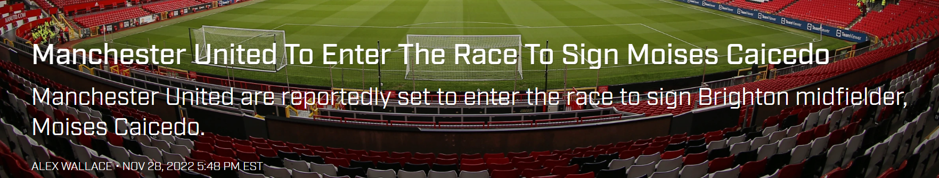
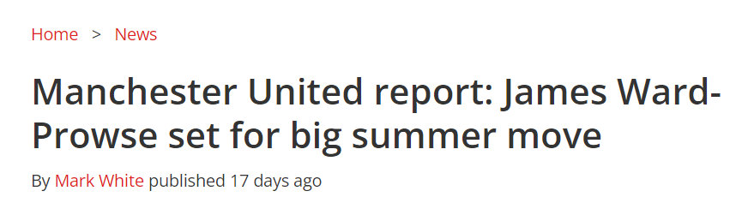
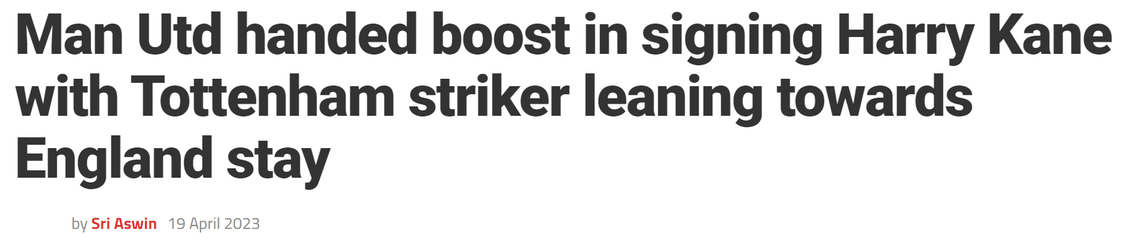
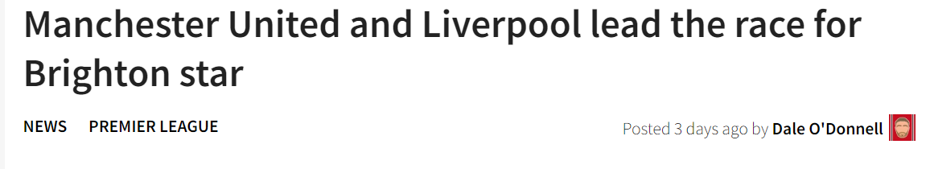
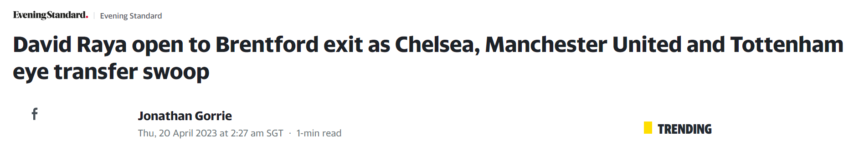
Manchester United’s Transfer Targets
Notes:
To have our analysis be as realistic as possible, we applied our models on actual Manchester United Player Targets in Harry Kane, Moises Caicedo, David Raya, James Ward-Prowse and Alexis Mac Allister.

Slide 47


Player Valuation Model Comparison
Based on 2021-2022 data
Transfer Targets | RFR Player Valuation | XGBoost Player Valuation
Moisés Caicedo | 12949000.00 | 4082235.75
David Raya | 8262000.00 | 8838544.00
Alexis Mac Allister | 9808000.00 | 18726884.00
James Ward-Prowse | 25545000.00 | 22507184.00
Harry Kane | 17618000.00 | 24064912.00
Current Valuation ???
2022-2023 season still ongoing
Will need the full seasons data for more accurate prediction
Notes:
Here’s the predictions from both models.
As the current 2022/2023 season is still ongoing, we predicted the valuations of these players based on their 2021/2022 statistics.
Looking at the predictions, the player valuations generated for Raya and Ward-Prowse are relatively similar, while there exists some disparity for the rest.
Empirical observations suggest XGBoost’s predictions makes more sense, while RFR’s predictions seem to be more conservative.
Most importantly, if the asking price of these players fall below the RFR / XGBoost estimates, Manchester United should definitely consider the purchase of these players to boost their playing squad.

Slide 48
Anomaly Detection Isolation Forest
Hyperparameters | Values
No. of Estimators | 100
Max Samples | ‘auto’
Contamination | ‘auto’
Max Features to train each estimator | 1
Player | Season
Alexander Büttner | 2013-2014
Tyler Blackett | 2014-2015
Paddy McNair | 2014-2015
… | …
Andreas Pereira | 2018-2019
Brandon Williams | 2019-2020
List of underperforming
outliers from training
Notes:
Moving on to anomaly detection, here’s the hyperparameters for the isolation forest on the left, together with a truncated list of underperforming outliers on the right from training.

Slide 49
Anomaly Detection One Class SVM
Hyperparameters | Values
Kernel | 'rbf’
nu | 0.15
gamma | ‘scale’
Player | Season
Ashley Young | 2013-2014
Tyler Blackett | 2014-2015
Paddy McNair | 2014-2015
… | …
Scott McTominay | 2018-2019
Andreas Pereira | 2018-2019
List of underperforming
outliers from training
Notes:
And likewise for the OCSVM,

Slide 50
Anomaly Detection SGD One Class SVM
Hyperparameters | Values
Kernel | 'rbf’
nu | 0.1
gamma | ‘scale’
Player | Season
Ashley Young | 2013-2014
Alexander Büttner | 2013-2014
Tyler Blackett | 2014-2015
… | …
Juan Mata | 2019-2020
Nemanja Matić | 2020-2021
List of underperforming
outliers from training
Notes:
SGD OCSVM

Slide 51

Anomaly Detection AutoEncoder
Player | Season
Paul Scholes | 2011-2012
Phil Jones | 2011-2012
… | …
Mason Greenwood | 2020-2021
Hyperparameters | Values
Bottleneck Dimensions | 2
Epochs | 600 with early stopping
Batch Size | 8
Training Metrics
Notes:
And AutoEncoder. As the autoencoder is trained on a semi-supervised basis, the corresponding training metrics are shown on the left here.

Slide 52
y
x
Isolation Forest
One Class Support Vector Machine
y
Iteratively updated
Bottleneck
x
Encoder
Decoder
SGD One Class Support Vector Machine
Deep autoencoder
Notes:
Now unlike the player valuation regression models, which are trained on a supervised basis,

Slide 53
y
x
Isolation Forest
One Class Support Vector Machine
y
Iteratively updated
Unsupervised Learning
x
SGD One Class Support Vector Machine
Notes:
These models are instead trained on either an unsupervised,

Slide 54
Semi-supervised Learning
Bottleneck
Encoder
Decoder
Deep autoencoder
Notes:
Or semi-supervised basis.

Slide 55
Anomaly Detection Model Comparison
1
0
All 4 models were used to predict underperforming Manchester United Players
Lack of “ground truth” in unsupervised learning
Difficult to compare the performance of these 4 models with one another
Notes:
Due to the lack of a "ground truth" in unsupervised learning, it is difficult to compare the performance of these 4 models with one another, and hence all 4 were used in the following section to predict underperforming Manchester United players over the 2021/2022 season.

Slide 56




Compiled List of Poor-Performing Anomalies over 2021/2022
Model | Poor Performing Players
Isolation Forest | Anthony Elanga
One Class SVM | Victor Lindelof, Nemenja Matic, Anthony Elanga
SGD One Class SVM | Alex Telles, Nemenja Matic, Anthony Elanga
Deep AutoEncoder | -
Notes:
Here’s the results from the predictions made by all models.
-- IGNORE --
The isolation forest algorithm identified Anthony Elanga as the only underperforming anomaly over 2021/2022. Both ocsvm and sgd ocsvm generated marginally more poor performing outliers, in victor lindelof, matic and elanga, as well as telles, matic and elanga again respectively. The deep autoencoder did not detect any anomalous underperforming players over 2021/2022.

Slide 57


Commonly Identified Poor-Performing Players
Nemenja Matic
Anthony Elanga
Notes:
Now if we scrutinise the players identified across these algorithms, two names stand out – nemenja matic, and Anthony elanga. Critically, these are the players that man u should let go.
Let’s take a deeper dive into their performances over 2021/2022.

Slide 58
Commonly Identified Poor-Performing Players
!
Fringe Player
Indeed, Matic had a difficult 2021/2022, failing to nail down a starting position in the team
Nemenja Matic
Notes:
First, for the case of matic, he indeed had a difficult 2021/2022, often utilized as a utility player to substitute for other players.
-- IGNORE --
He was 33 years of age, and into his 5th season at Manchester united. With other younger players such as Fred and Scott McTominay in the team, Matic failed to nail down a starting position.

Slide 59
Commonly Identified Poor-Performing Players
Breakthrough Season
?
On the other hand, the 2021/2022 season was a breakthrough season for Anthony Elanga, and he was frequently the bright spark for the team towards the tail end of the season
Unfortunate Coincidence
@
Elanga's breakthrough unfortunately coincided with Manchester United's dip in form towards the end of the season, which has definitely hampered Elanga's plus-minus ratings
Analysis Limitations
Anthony Elanga
-
Our method of analysis does not factor in the weightage of the player's contribution in matches - a limitation of our analysis.
Notes:
Now lets us take a look at the curious case of Anthony elanga. The appearance of Elanga in ¾ anomaly detection models was shocking, for 2021/2022 was his breakthrough season. Towards the tail end of the season, with injuries to other key players, elanga took over as the bright spark of the team. Unfortunately, his rise also coincided with Manchester united’s dip in form. This definitely hampered Elanga’s stats drastically as compared to his other teammates, who had the games from the start of the season to dilute their ratings.
Hence, this goes to show a critical limitation of our analysis. It does not factor in the weightage of the player’s contribution to goals conceded and goals scored in matches.

Slide 60
Future Work & Learning Outcomes Analysis Pipeline Improvements | What did we learn?

Slide 61
Areas for improvement
1
2
3
More metrics
Footage Analysis
Interdisciplinary
Thinking
It would be naïve to assume that a player’s value is solely based on their playing stats. Other interdisciplinary factors which should be considered are their public image and marketing value
Adding a bigger variety of different statistics to paint a more holistic picture of the player's performance on the field
Analysing real-life footage from football games and retrieving various different metrics in the player's movement and off-the-ball contributions.

Slide 62
What we learned
8 different yet intriguing models
Player Valuation
Random Forest Regressor
Support Vector Regression
Artificial Neural Network
Gradient Boosting

Slide 63
What we learned
8 different yet intriguing models
Anomaly detection
One Class Support Vector Machine
Isolation Forest
GD One Class Support Vector Machine
Deep autoencoder

Slide 64


What we learned
Acquired scraping skillsets which would be essential for projects when datasets are not easily found
Increases access to reputable data sources which can be used to make more informed predictions

Slide 65
Thank you!

